Slide 1

Organizational Culture and Environment
Chapter Three
Copyright © 2005 Prentice Hall, Inc. All rights reserved.
3–<number>

Slide 2
The Manager: Omnipotent or Symbolic?
Omnipotent View of Management
  Managers are directly responsible for an organization’s success or failure.
  The quality of the organization is determined by the quality of its managers.
  Managers are held most accountable
  for an organization’s performance
  yet it is difficult to attribute
  good or poor performance
  directly to their influence
  on the organization.
Copyright © 2005 Prentice Hall, Inc. All rights reserved.
3–<number>

Slide 3

The Manager: Omnipotent or Symbolic?
Symbolic View of Management
  Much of an organization’s success or failure is due to external forces outside of managers’ control.
  The ability of managers to affect outcomes is influenced and constrained by external factors.
    The economy, customers, governmental policies, competitors, industry conditions,
    technology, and the actions of
    previous managers
  Managers symbolize control and
  influence through their action.
Copyright © 2005 Prentice Hall, Inc. All rights reserved.
3–<number>

Slide 4

Parameters of Managerial Discretion
Copyright © 2005 Prentice Hall, Inc. All rights reserved.
Exhibit 3.1
3–<number>

Slide 5

The Organization’s Culture
Organizational Culture
  A system of shared meanings and common beliefs held by organizational members that determines, in a large degree, how they act towards each other.
  “The way we do things around here.”
    Values, symbols, rituals, myths, and practices
  Implications:
    Culture is a perception.
    Culture is shared.
    Culture is descriptive.
Copyright © 2005 Prentice Hall, Inc. All rights reserved.
3–<number>

Slide 6
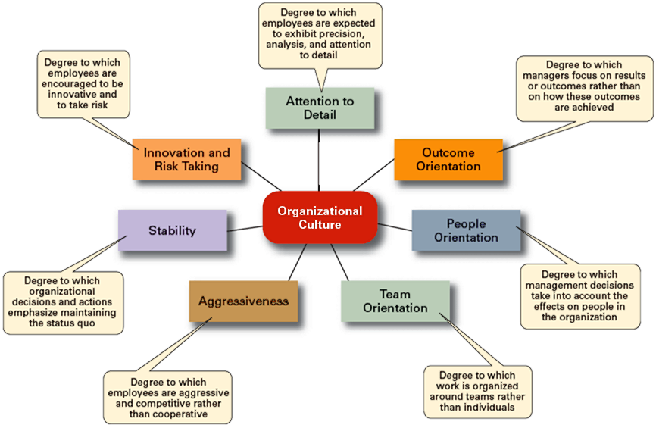
Dimensions of Organizational Culture
Copyright © 2005 Prentice Hall, Inc. All rights reserved.
Exhibit 3.2
3–<number>

Slide 7
Strong versus Weak Cultures
Strong Cultures
  Are cultures in which key values are deeply held and widely held.
  Have a strong influence on organizational members.
Factors Influencing the Strength of Culture
  Size of the organization
  Age of the organization
  Rate of employee turnover
  Strength of the original culture
  Clarity of cultural values and beliefs
Copyright © 2005 Prentice Hall, Inc. All rights reserved.
3–<number>

Slide 8

Benefits of a Strong Culture
Creates a stronger employee commitment to the organization.
Aids in the recruitment and socialization of new employees.
Fosters higher organizational
performance by instilling and
promoting employee initiative.
Copyright © 2005 Prentice Hall, Inc. All rights reserved.
3–<number>

Slide 9
Organizational Culture
Sources of Organizational Culture
  The organization’s founder
    Vision and mission
  Past practices of the organization
    The way things have been done
  The behavior of top management
Continuation of the Organizational Culture
  Recruitment of like-minded employees who “fit”
  Socialization of new employees to help them adapt to the culture
Copyright © 2005 Prentice Hall, Inc. All rights reserved.
3–<number>

Slide 10
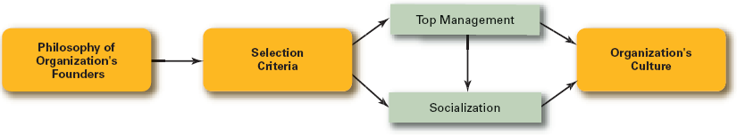
How an Organization’s Culture Is Established and Maintained
Copyright © 2005 Prentice Hall, Inc. All rights reserved.
Exhibit 3.4
3–<number>

Slide 11
How an Organization’s Culture Is Established and Maintained
Copyright © 2005 Prentice Hall, Inc. All rights reserved.
Exhibit 3.4
3–<number>

Slide 12
How Employees Learn Culture
Stories
  Narratives of significant events or actions of people that convey the spirit of the organization
Rituals
  Repetitive sequences of activities that express and reinforce the values of the organization
Material Symbols
  Physical assets distinguishing the organization
Language
  Acronyms and jargon of terms, phrases, and word meanings specific to an organization
Copyright © 2005 Prentice Hall, Inc. All rights reserved.
3–<number>

Slide 13
How Culture Affects Managers
Cultural Constraints on Managers
  Whatever managerial actions the organization recognizes as proper or improper on its behalf
  Whatever organizational activities the organization values and encourages
  The overall strength or weakness of the organizational culture
  Simple rule for getting ahead in an organization:
  Find out what the organization rewards and do those things.
Copyright © 2005 Prentice Hall, Inc. All rights reserved.
3–<number>

Slide 14
Suggestions for Managers: Creating a More Ethical Culture
Be a visible role model.
Communicate ethical expectations.
Provide ethics training.
Visibly reward ethical acts and punish unethical ones.
Provide protective mechanisms so employees can discuss ethical dilemmas and report unethical behavior without fear.
Copyright © 2005 Prentice Hall, Inc. All rights reserved.
Exhibit 3.6
3–<number>

Slide 15
Defining the External Environment
External Environment
  The forces and institutions outside the organization that potentially can affect the organization’s performance.
Components of the External Environment
  Specific environment: external forces that have a direct and immediate impact on the organization.
  General environment: broad economic, socio-cultural, political/legal, demographic, technological, and global conditions that may affect the organization.
Copyright © 2005 Prentice Hall, Inc. All rights reserved.
3–<number>

Slide 16
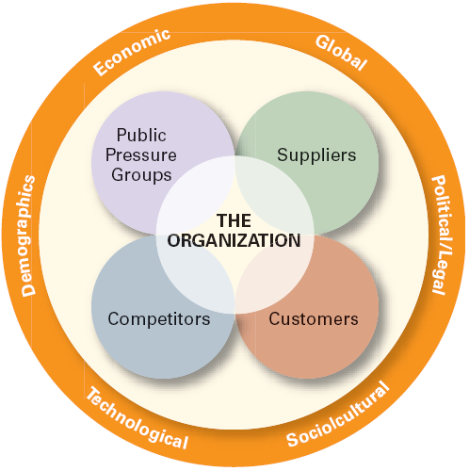
The External Environment
Copyright © 2005 Prentice Hall, Inc. All rights reserved.
Exhibit 3.8
3–<number>

Slide 17
How the Environment Affects Managers
Environmental Uncertainty
  The extent to which managers have knowledge of and are able to predict change their organization’s external environment is affected by:
    Complexity of the environment: the number of components in an organization’s external environment.
    Degree of change in environmental components: how dynamic or stable the external environment is.
Copyright © 2005 Prentice Hall, Inc. All rights reserved.
3–<number>

Slide 18
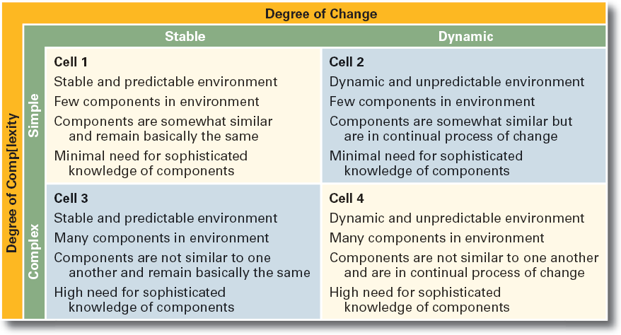
Environmental Uncertainty Matrix
Copyright © 2005 Prentice Hall, Inc. All rights reserved.
Exhibit 3.10
3–<number>

Slide 19
Stakeholder Relationships
Stakeholders
  Any constituencies in the organization’s external environment that are affected by the organization’s decisions and actions
Why Manage Stakeholder Relationships?
  It can lead to improved organizational performance.
  It’s the “right” thing to do given the interdependence of the organization and its external stakeholders.
Copyright © 2005 Prentice Hall, Inc. All rights reserved.
3–<number>

Slide 20
Managing Stakeholder Relationships
Identify the organization’s external stakeholders.
Determine the particular interests and concerns of the external stakeholders.
Decide how critical each external stakeholder is to the organization.
Determine how to manage each individual external stakeholder relationship.
Copyright © 2005 Prentice Hall, Inc. All rights reserved.
3–<number>

Slide 21
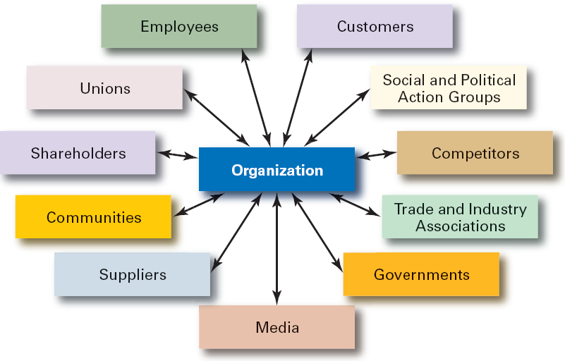
Organizational Stakeholders
Copyright © 2005 Prentice Hall, Inc. All rights reserved.
Exhibit 3.11
3–<number>

Slide 22
Managing in a Global Environment
Chapter Four
Copyright © 2005 Prentice Hall, Inc. All rights reserved.
3–<number>

Slide 23
The Global Marketplace
Opportunities and Challenges
  Coping with the sudden appearance of new competitors
  Acknowledging cultural, political, and economic differences
  Dealing with increased uncertainty, fear, and anxiety
  Adapting to changes in the global environment
  Avoiding parochialism
© 2007 Prentice Hall, Inc. All rights reserved.
4–<number>

Slide 24
What’s Your Global Perspective?
Parochialism
  Is viewing the world solely through its own eyes and perspectives.
  Is not recognizing that others have different ways of living and working.
  Is a significant obstacle for managers working in a global business world.
  Is falling into the trap of ignoring others’ values and customs and rigidly applying an attitude of “ours is better than theirs” to foreign cultures.
© 2007 Prentice Hall, Inc. All rights reserved.
4–<number>

Slide 25
Adopting a Global Perspective
Ethnocentric Attitude
  The parochialistic belief that the best work approaches and practices are those of the home country.
Polycentric Attitude
  The view that the managers in the host country know the best work approaches and practices for running their business.
Geocentric Attitude
  A world-oriented view that focuses on using the best approaches and people from around the globe.
© 2007 Prentice Hall, Inc. All rights reserved.
4–<number>

Slide 26
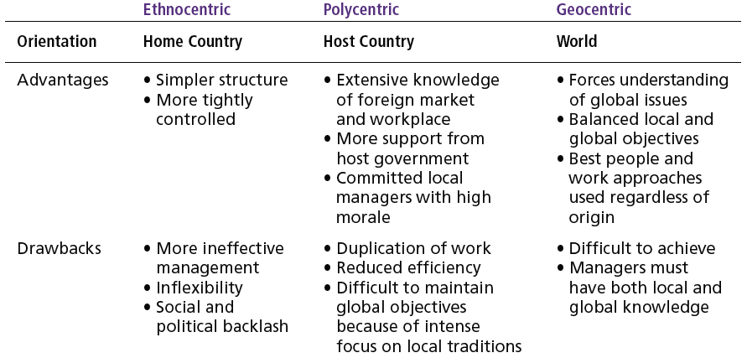
Exhibit 4–1 Key Information About Three Global Attitudes
© 2007 Prentice Hall, Inc. All rights reserved.
4–<number>

Slide 27
Different Types of International Organizations
Multinational Corporation (MNC)
  Maintains operations in multiple countries.
Multidomestic Corporation
  Is an MNC that decentralizes management and other decisions to the local country.
Global Company
  Is an MNC that centralizes its management and other decisions in the home country.
© 2007 Prentice Hall, Inc. All rights reserved.
4–<number>

Slide 28
Different Types of International Organizations
Multinational Corporation (MNC)
  Maintains operations in multiple countries.
Multidomestic Corporation
  Is an MNC that decentralizes management and other decisions to the local country.
Global Company
  Is an MNC that centralizes its management and other decisions in the home country.
© 2007 Prentice Hall, Inc. All rights reserved.
4–<number>

Slide 29
Different Types of International Organizations (cont’d)
Transnational Corporation (Borderless Organization)
  Is an MNC that has eliminated structural divisions that impose artificial geographic barriers and is organized along business lines that reflect a geocentric attitude.
Born Globals/International New Ventures (INVs)
  Commit resources upfront (material, people, financing) to doing business in more than one country.
© 2007 Prentice Hall, Inc. All rights reserved.
4–<number>

Slide 30
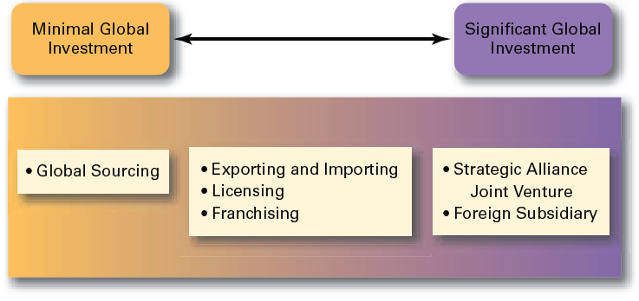
Exhibit 4–5 How Organizations Go Global
© 2007 Prentice Hall, Inc. All rights reserved.
4–<number>

Slide 31
Other Forms of Globalization
Strategic Alliances
  Partnerships between and organization and a foreign company in which both share resources and knowledge in developing new products or building new production facilities.
Joint Venture
  A specific type of strategic alliance in which the partners agree to form a separate, independent organization for some business purpose.
Foreign Subsidiary
  Directly investing in a foreign country by setting up a separate and independent production facility or office.
© 2007 Prentice Hall, Inc. All rights reserved.
4–<number>

Slide 32

Managing in A Global Environment
The Legal Environment
  Stability or instability of legal and political systems
    Legal procedures are established and followed
    Fair and honest elections held on a regular basis
  Differences in the laws of various nations
    Effects on business activities
    Effects on delivery of products and services
© 2007 Prentice Hall, Inc. All rights reserved.
4–<number>

Slide 33
The Economic Environment
Economic Systems
  Market economy
    An economy in which resources are primarily owned and controlled by the private sector.
  Command economy
    An economy in which all economic decisions are planned by a central government.
Monetary and Financial Factors
  Currency exchange rates
  Inflation rates
  Diverse tax policies
© 2007 Prentice Hall, Inc. All rights reserved.
4–<number>

Slide 34
The Cultural Environment
National Culture
  Is the values and attitudes shared by individuals from a specific country that shape their behavior and their beliefs about what is important.
  May have more influence on an organization than the organization culture.
© 2007 Prentice Hall, Inc. All rights reserved.
4–<number>

Slide 35
Hofstede’s Framework for Assessing Cultures
Individualism
versus
Collectivism
Long-Term
versus
Short-Term Orientation
Power
Distance
Culture
Achievement versus Nurturing
Uncertainty
Avoidance
© 2007 Prentice Hall, Inc. All rights reserved.
4–<number>

Slide 36
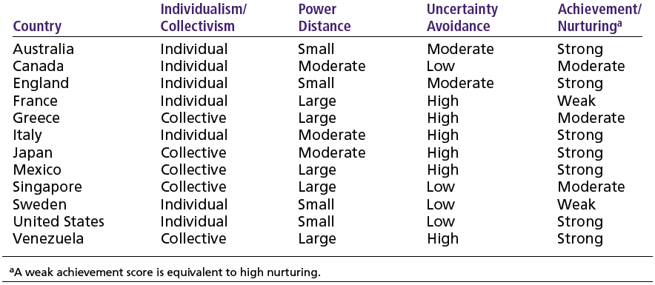
Exhibit 4–7 Examples of Hofstede’s Cultural Dimensions
Source: Based on G. Hofstede, “Motivation, Leadership, and Organization: Do American Theories Apply Abroad?” Organizational Dynamics, Summer 1980, pp. 42–63.
© 2007 Prentice Hall, Inc. All rights reserved.
4–<number>

Slide 37
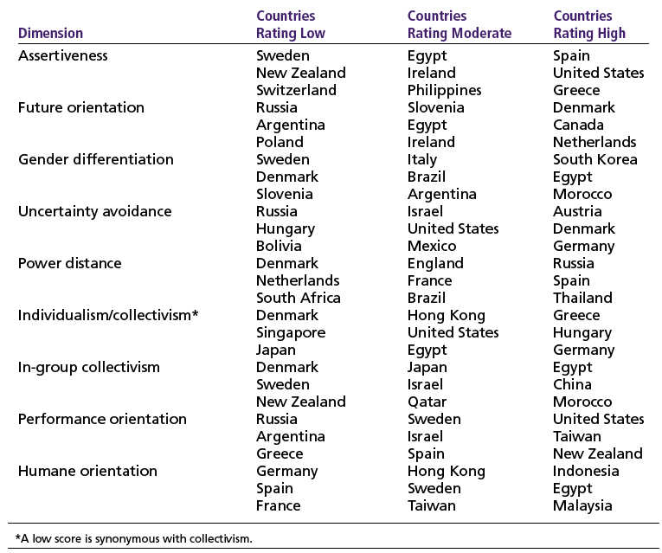
Exhibit 4–8 GLOBE Highlights
Source: M. Javidan and R. J. House, “Cultural Acumen for the Global Manager: Lessons from Project GLOBE,” Organizational Dynamics, Spring 2001, pp. 289–305. Copyright © 2001. Reprinted with permission from Elsevier.
© 2007 Prentice Hall, Inc. All rights reserved.
4–<number>

Slide 38
Thank You
Copyright © 2005 Prentice Hall, Inc. All rights reserved.
3–<number>

